Slide 1
Individual Assignment Minor Data-Driven Decision Making
AI powered rental alert system
AI Agent- for automation

Slide 2

What is an AI Agent?
A digital assistant that performs tasks for you automatically
Think of it as an automated version of yourself online
Saves time and effort by doing complex actions for you

Slide 3
Real-Life Examples of AI Agents
Buy products on Amazon for you
Search Google and collect URLs
Book flights or movie tickets
Apply for jobs using your CV
Read and reply to emails

Slide 4
How AI Agents Are Created
Built using tools like BrowserUse and WEB UI
Powered by Large Language Models (LLMs)

Slide 5
Tools to Build AI Agents
BrowserUse (Open-source)
- Automates browser like a human
- Works with a visual Web UI
- Create step-by-step workflows
- Use triggers, tools, and LLMs

Slide 6

What is a Large Language Model (LLM)?
Gives 'intelligence' to the AI agent
Understands natural language tasks
Examples of LLMs:
- DeepSeek R1 (via Ollama or OpenRouter)
- Gemini 2.0 Flash
- GPT-4o (OpenAI)

Slide 7
Setting Up BrowserUse (Simple Steps)
Install Python, BrowserUse, and Playwright
1
Set up the Web UI using provided commands
2
Connect your LLM and input tasks in plain language
3
Agent performs the task and shows results
4

Slide 8

Here is an AI agent that I built

Slide 9

Click here to watch the video
Click here to watch the video on Google Drive

Slide 10
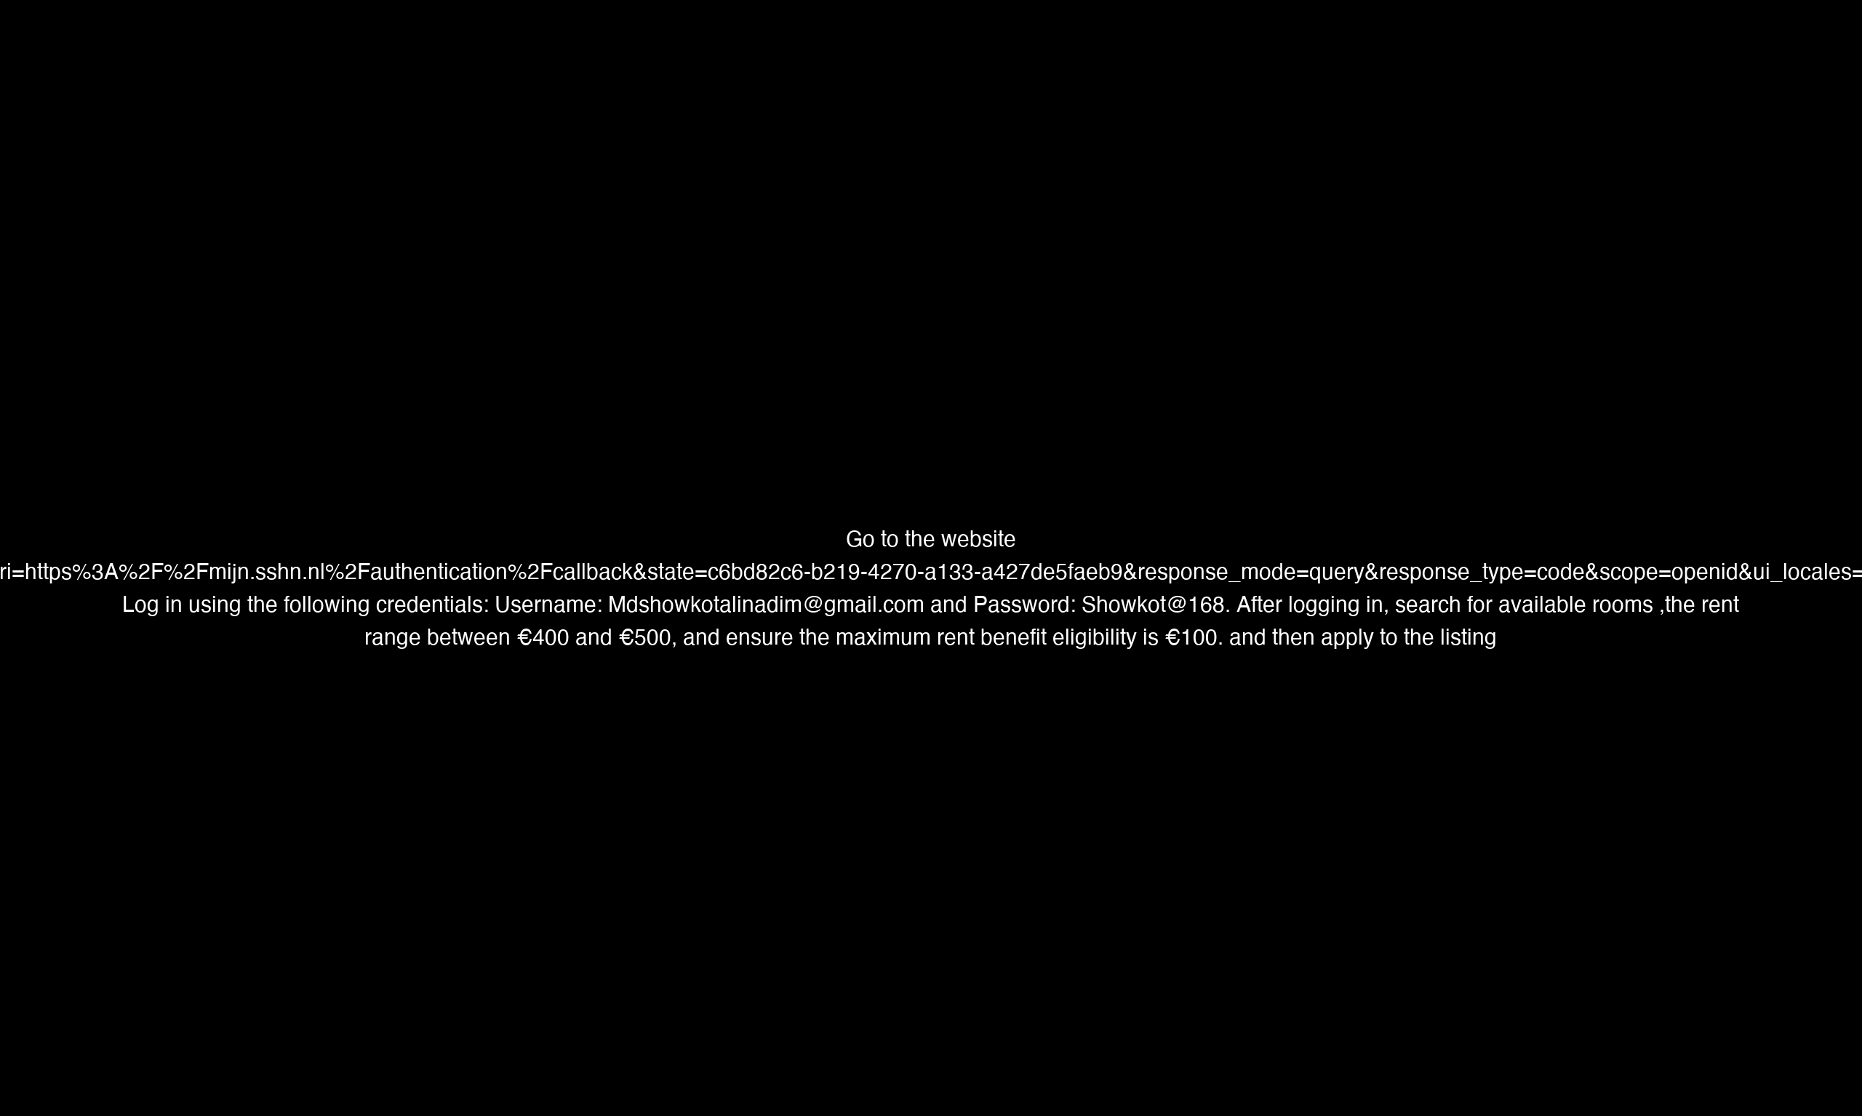

Slide 11
Thank you for your attention

